Slide 1
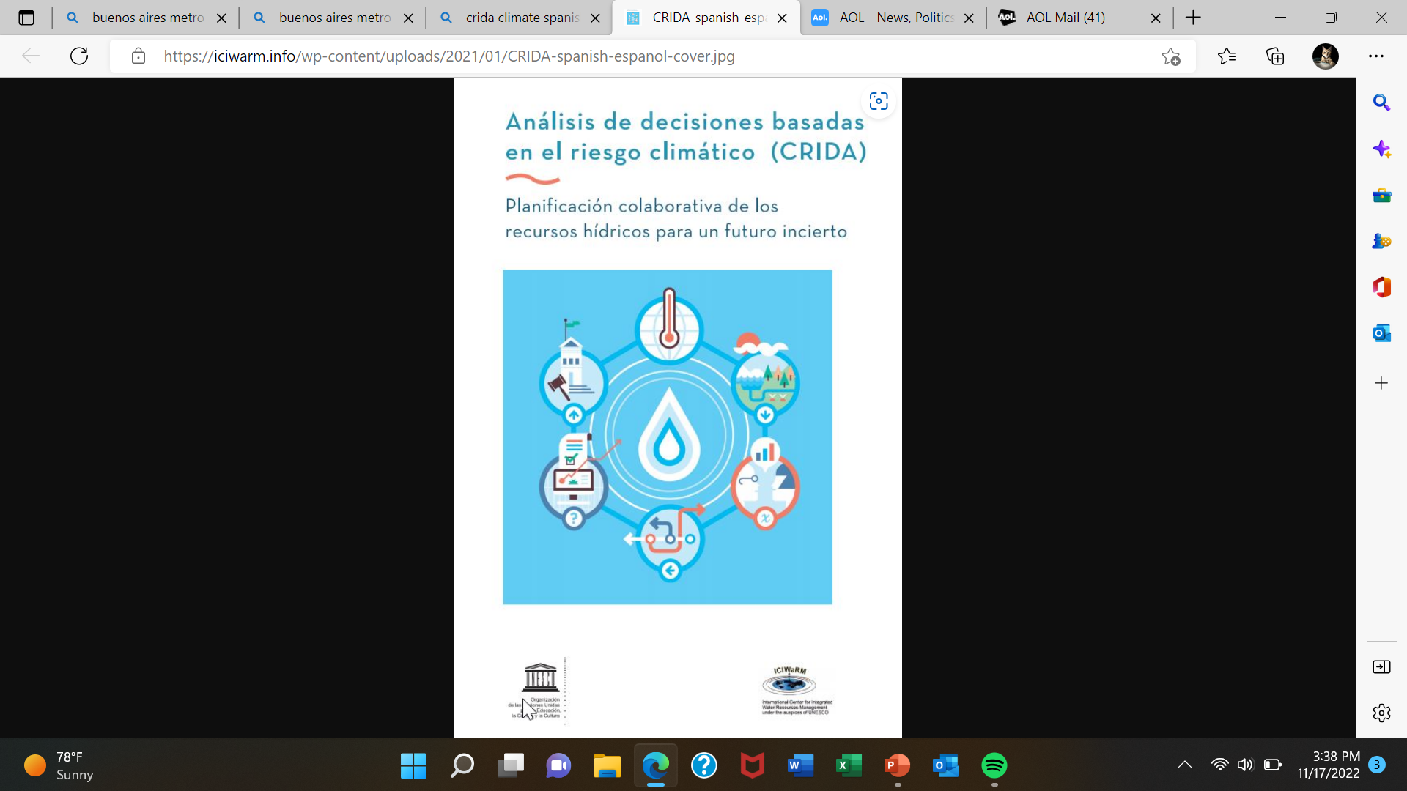
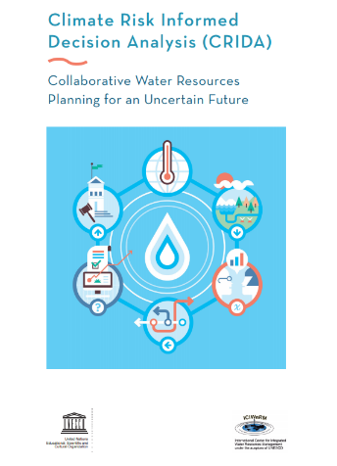
Climate Risk-Informed Decision Analysis (CRIDA): Integrating Climate Resilience within Existing Water Resources Planning, Design and Operations
William S. (Will) Logan, PhD
Director, International Center for Integrated Water Resources Management (ICIWaRM)
Institute for Water Resources, USACE
Collaborators include UNESCO, Deltares, Alliance for Global Water Adaptation (AGWA), University of Massachusetts, University of Cincinnati, (Rijkswaterstaat, World Bank)

Slide 2
Why CRIDA?
There’s been a lot of thinking about Climate Adaptation and about Water Resources Management
Many seem to think that we need to treat our adaptation challenges as a climate science problem.
I.e., climate science can come in and rescue us and provide us with resilient systems.
But water resources management is still a water problem. We need to build on what we know, not take an entirely new direction.

Slide 3
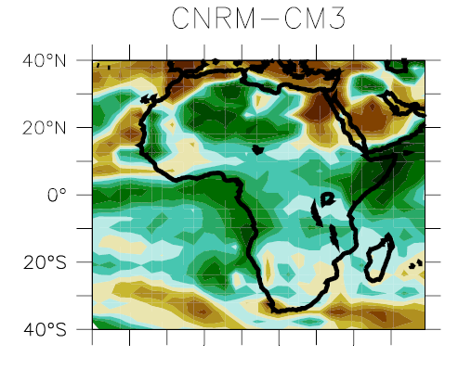
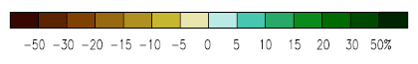
Climate models, designed and run by climatologists, project future climate
Meteo-France model, from IPCC

Slide 4
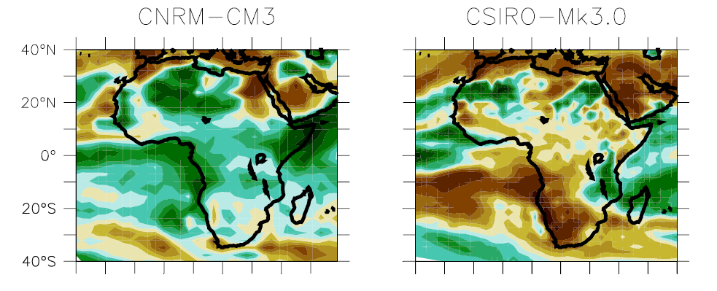
But they often disagree with each other
The Meteo-France and Australian models (IPCC)

Slide 5
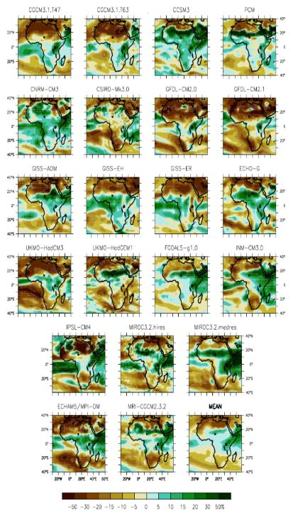
… and we don’t have just two models… We have lots of models…

Slide 6
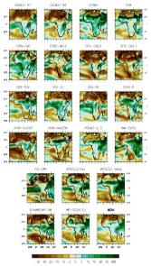
… and future climates depend on future climate policies and socio-economic trends…

Slide 7
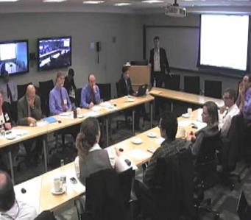
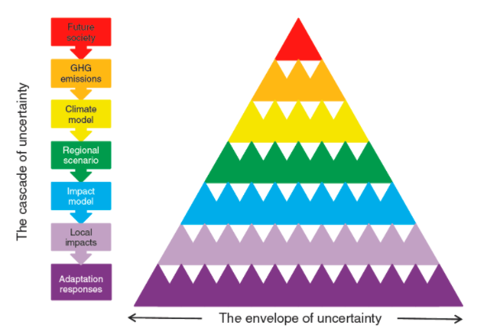
The Frustration with Downscaling Global Climate Models and the Origin of CRIDA
World Bank 2011
“We hire a contractor to help assess climate change impacts. On completion an inch thick report is produced to state that the future is uncertain” Luis Garcia, World Bank
Wilby and Dessai 2010

Slide 8
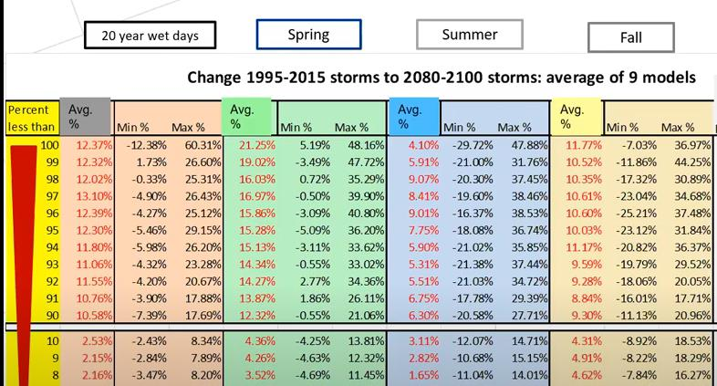
Prediction Variation among 9 GCMs for Philadelphia, USA by Storm Size and Season
Source: Mark Maimone, CDM-Smith, 2020

Slide 9
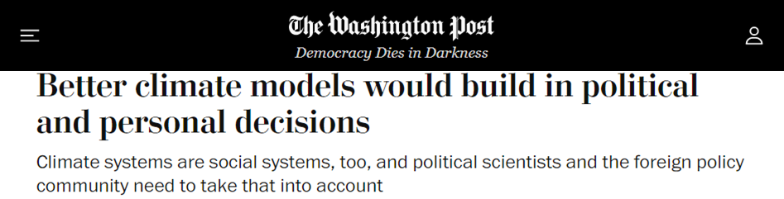

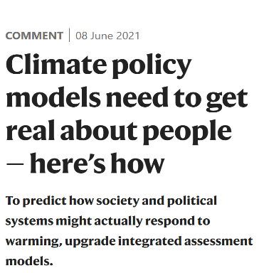
Some people think we just need more complex climate models…REALLY?
• Access to capital
• Subsidies of green or gray technologies
* Interest group mobilization
• Carbon lock-in
• Environmental justice/ moral acceptability
• Public opinion
• Confidence in political institutions
• Trade and investment policies
• State intervention in markets
• Cost of deploying capital. • Etc…etc…etc…

Slide 10
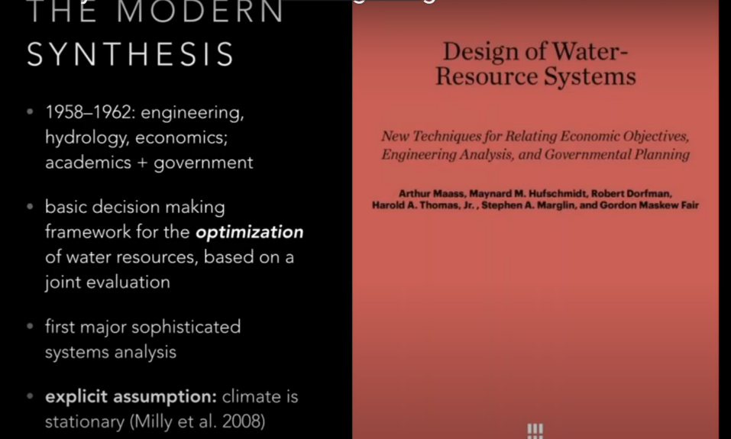
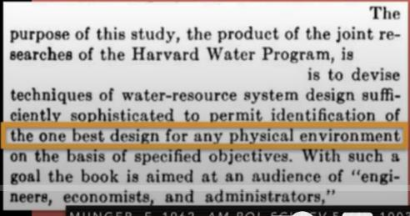
We have spent a lot of time trying to optimize water plans, rather than making them robust to changing conditions

Slide 11
Unhelpful GCM-based Planning vs. Bottom-Up Scenario Planning with Stakeholders
Planning Scenarios
GCMs
Forecasting - Optimization (top-down)
3. Determine plausibility and consequence
1. Downscale multiple model projections
2. Hope the GCMs are correct.
3. Generate a few water supply series.
Critical climate and other urbanization stressors
2. Stress Test
4. Find whether system is vulnerable for these series
Scenario Planning – Risk Informed (bottom-up)
Vulnerability domain
Tested vulnerability domain
What keeps a planner awake at night?
1a. Perform Vulnerability Assessments with Stakeholders
Notes:
11

Slide 12
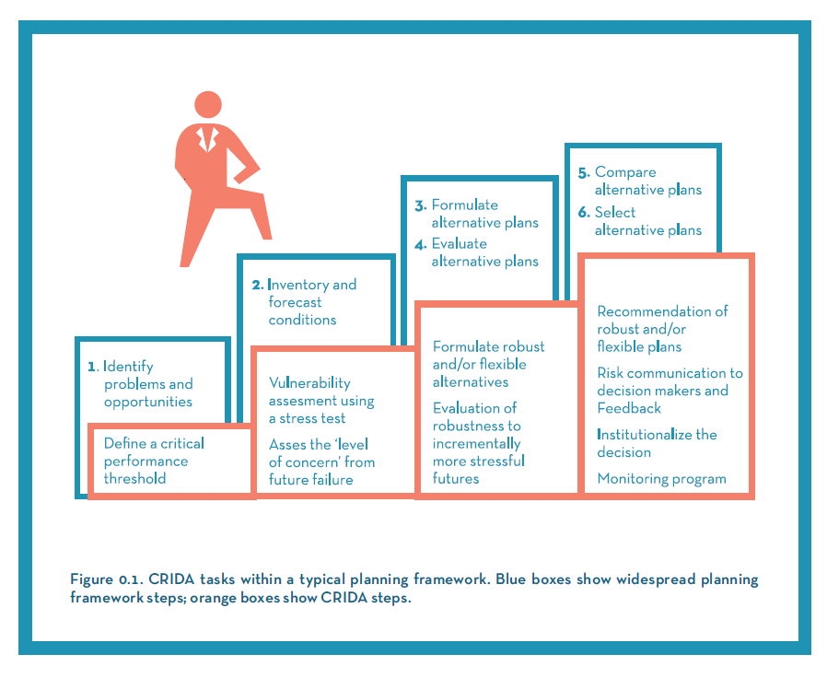
CRIDA Steps (orange) Parallel Typical Water Resources Planning Steps (blue)

Slide 13
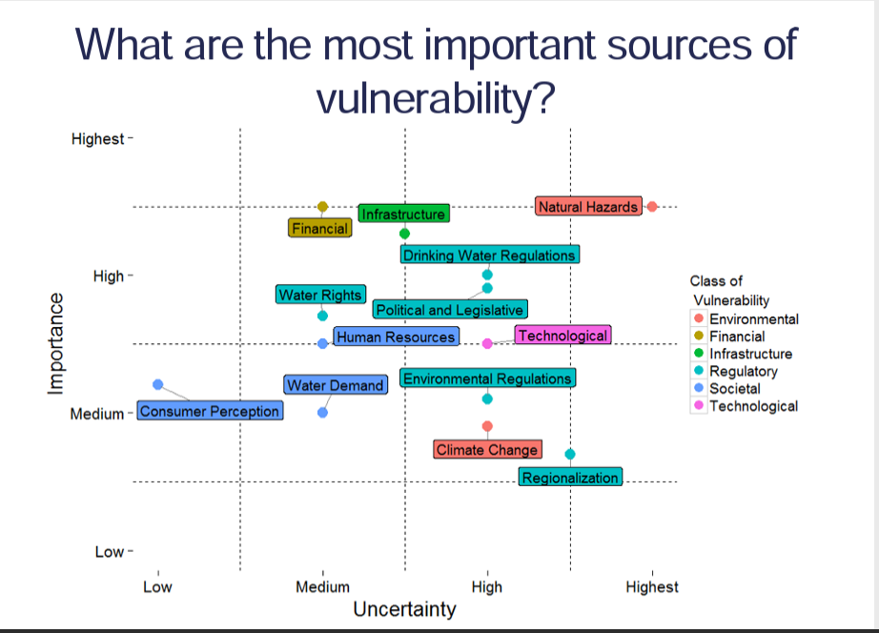
Sometimes system failure is not all about climate change
Alexis Dufour, SFPUC Water Enterprise
Notes:
Note the huge number of potential uncertainties. Climate is one of 13.

Slide 14
Step 1: Structuring a Collaborative Process for Vulnerability Assessment
Water resources system model
External drivers
Performance metrics
Critical thresholds

Slide 15
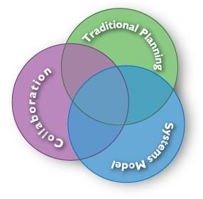
Shared Vision Planning/ Stakeholder Engagement
Shared Vision Planning (SVP) is a collaborative approach to formulating water management solutions that combines three disparate practices:
Traditional water resources planning
Structured public participation &
Collaborative computer modeling
Notes:
Stacy

Slide 16
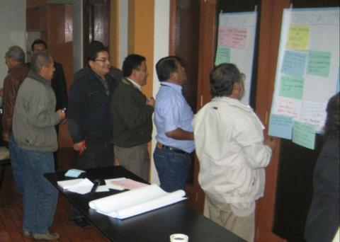
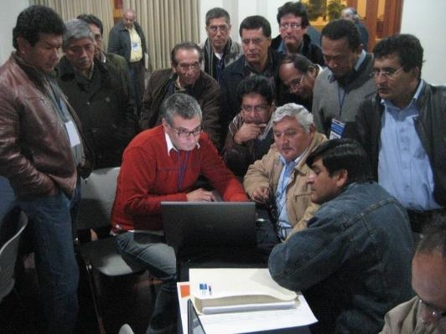
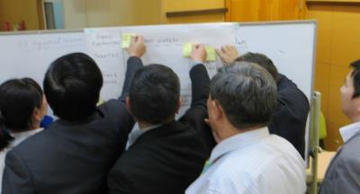
Stakeholders know lots about your system, and know what system failure is all about

Slide 17
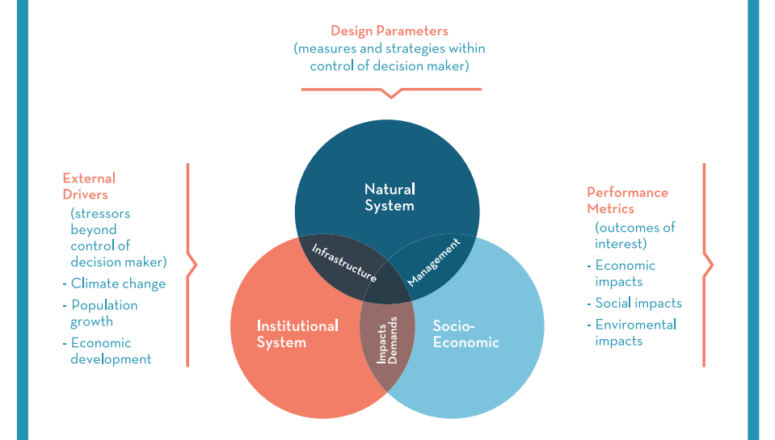
Key Elements of a Water Resources Systems Model

Slide 18
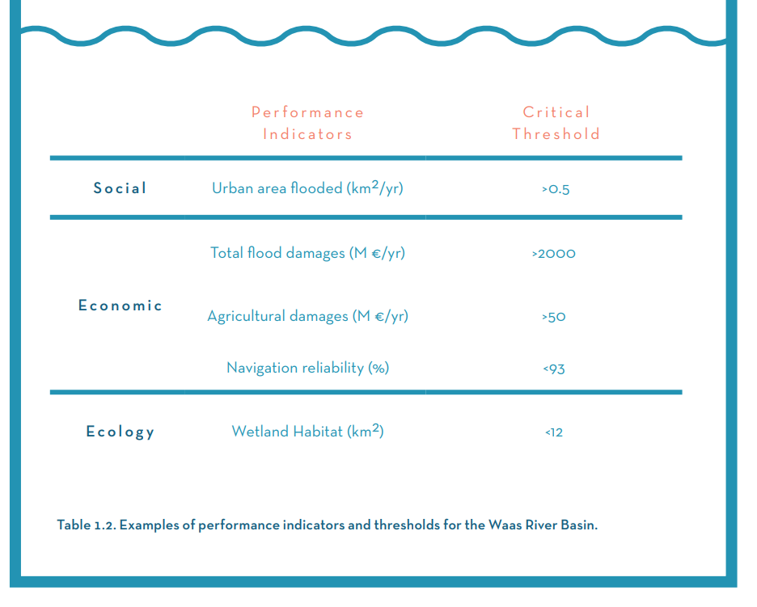

Slide 19
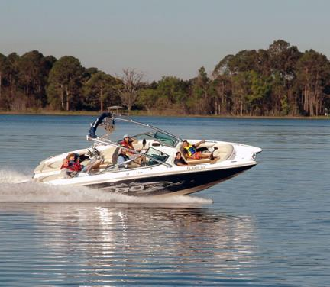
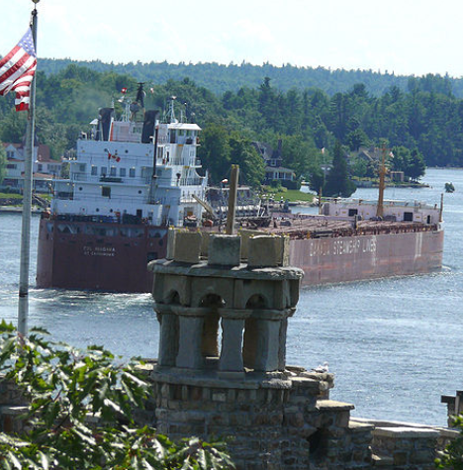
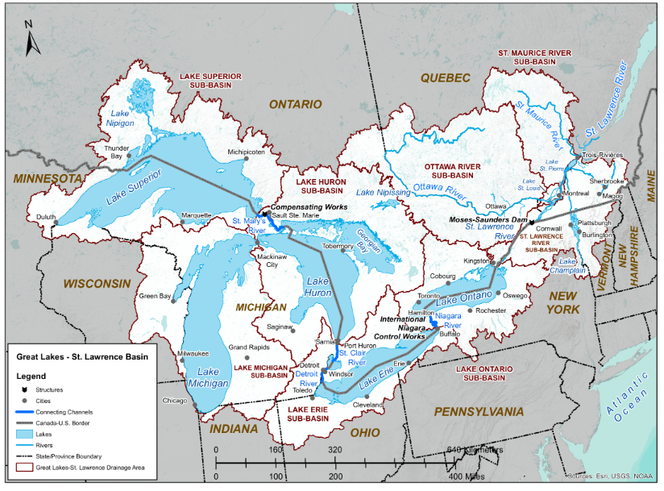
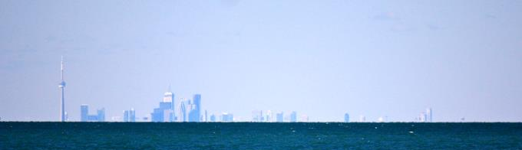
Many interest groups, which may have lots of suggestions for performance indicators
Example from the Binational (US-Canada) Great Lakes-St. Lawrence Seaway system
1. Recreation Boating & Tourism
2. Commercial Navigation
3. Environment
4. Municipal and Industrial Water Uses
5. Hydropower
6. Coastal

Slide 20

Some examples of Great Lakes Performance Indicators
Economic
Transportation costs (Navigation)
Infrastructure Investment Costs (Municipal/Industrial)
Water Quality Investments (Municipal/Industrial)
Willingness to Pay (Recreation)
Cost of foregone peaking opportunities (Hydropower)
Environmental Quality
32 key performance indicators (too many!)
Social well-being
Beach access (Coastal)
Four indicators for Floods (Coastal)

Slide 21
Step 2: Implementing a Bottom-up Vulnerability Assessment
Input from Step 1
• Water resources system model
• External drivers
• Performance metrics
• Critical thresholds
Output from Step 2
• Stress test results showing the limits of performance
• An assessment of the plausibility that future stressors will lead to unacceptable performance
• An assessment of analytical uncertainty and how it affects the choice of options
• A measure of level of concern based on the assessment of plausibility and analytical uncertainty

Slide 22
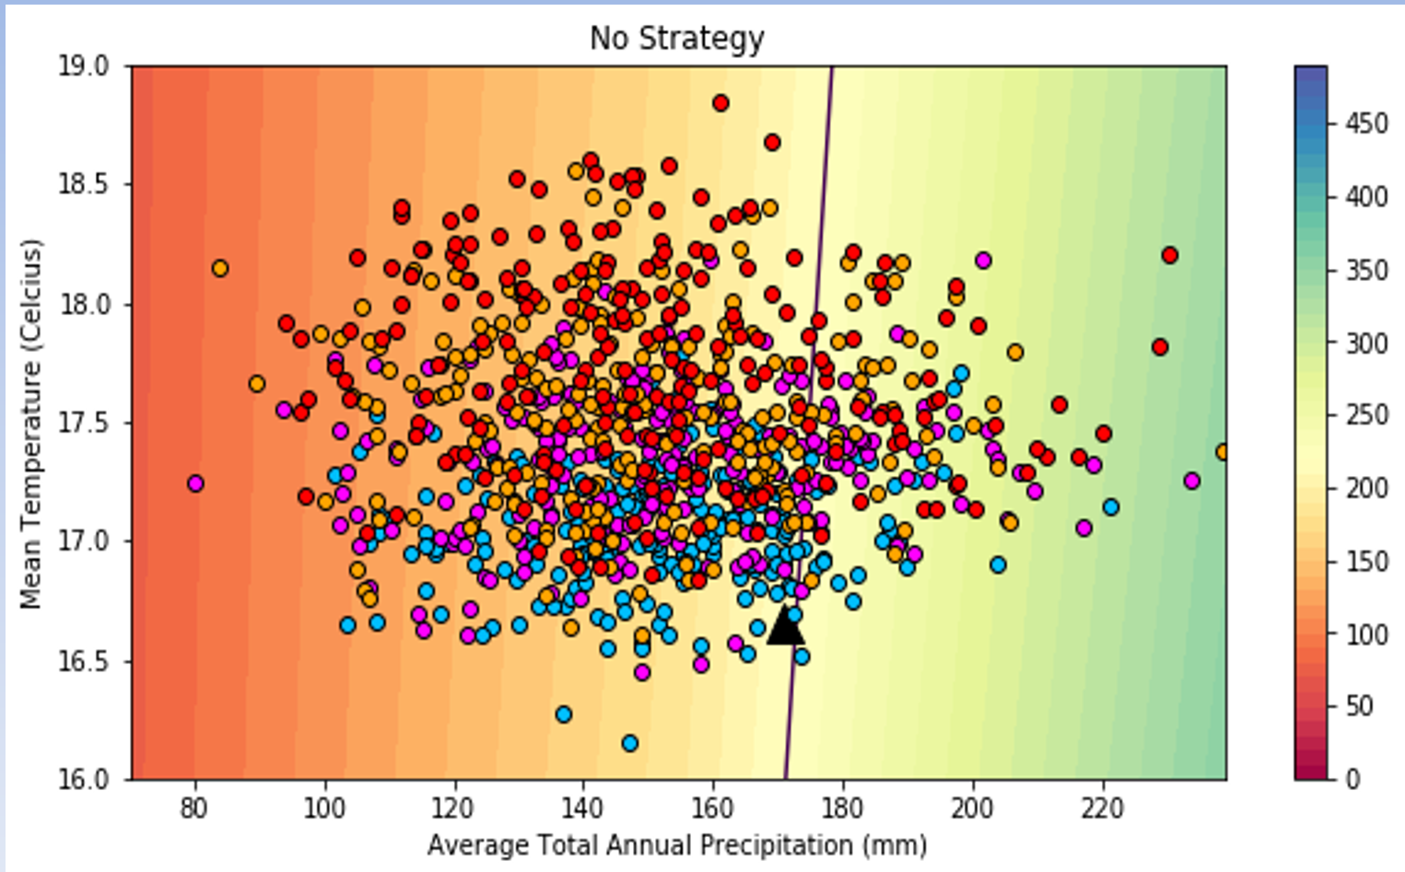
Vulnerability Assessment – Stress Test
Plausibility of “Failure”
(In this case, <220 hm3 flow into the reservoir, Limari Basin, Chile)
Source: Koen Verbist

Slide 23
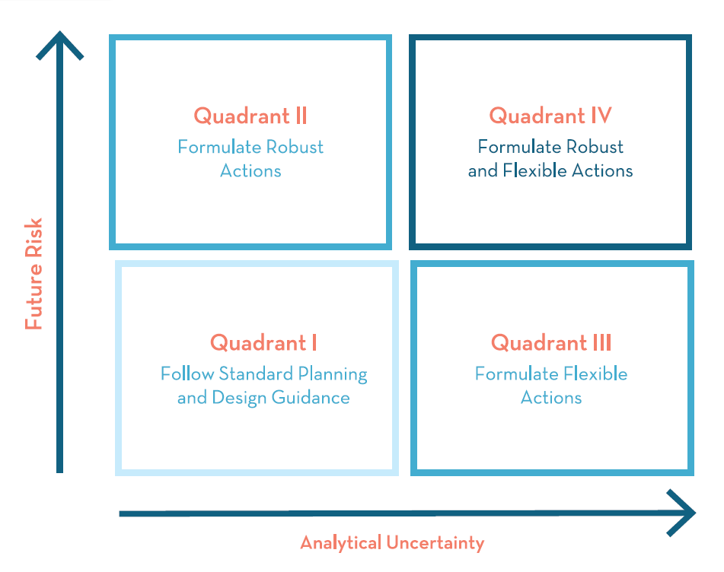
(a) High scatter in data and (b) ~75% of simulations suggesting system failure puts us in Quadrants III or IV
Notes:
Level of concern:• Does credible evidence suggest a threshold will be crossed leading to unacceptable
performance?
• Is the confidence level of the analysis sufficient to make a risk-informed decision?
In Limari, concern was estimated with questionnaires. In San Francisco, with an expert panel

Slide 24
Step 3: Formulating Alternative Plans
Input from Step 2
• Stress test results showing the limits of performance
• An assessment of the plausibility that future stressors will lead to unacceptable performance
• An assessment of analytical uncertainty and how it affects the choice of options
• A measure of Level of Concern, based on the assessment of plausibility and analytical uncertainty
Output from Step 3
• Robust and flexible plans, based on
- reducing relative risks and
- comparing alternative solution comprehensiveness, effectiveness, and stakeholder acceptability

Slide 25
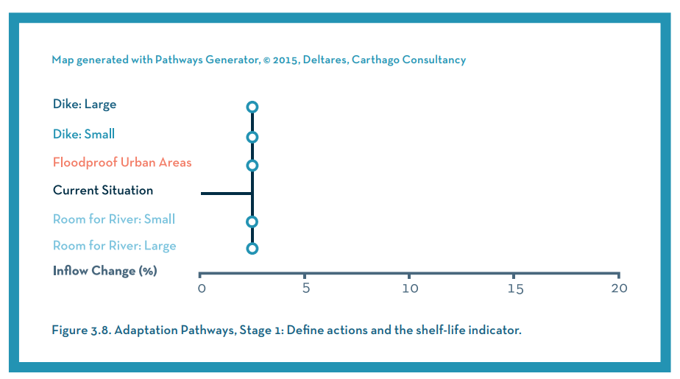
Developing an “Adaptation Pathways” Map

Slide 26
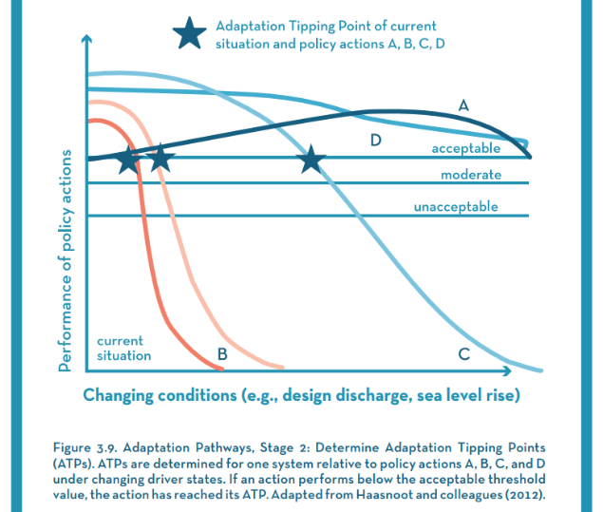
Developing Adaptation Pathways “Tipping Points”

Slide 27
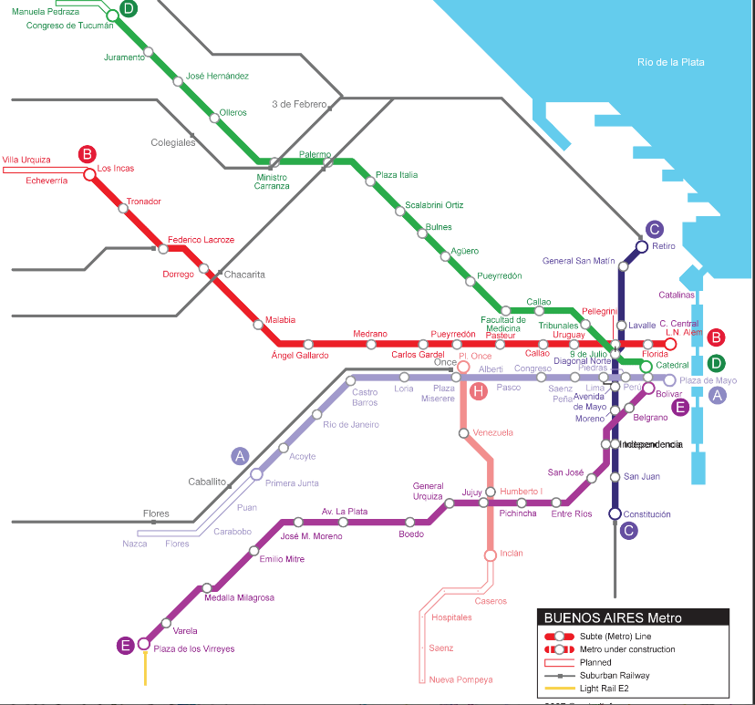
Adaptation Pathways as a metro system
Some paths are shorter
But maybe the trains break down earlier
But in some cases if I know that, I can detour around a problem.
Or maybe I should take a taxi, but it’s expensive.
Or walk, which is free, low-risk but high-effort.

Slide 28
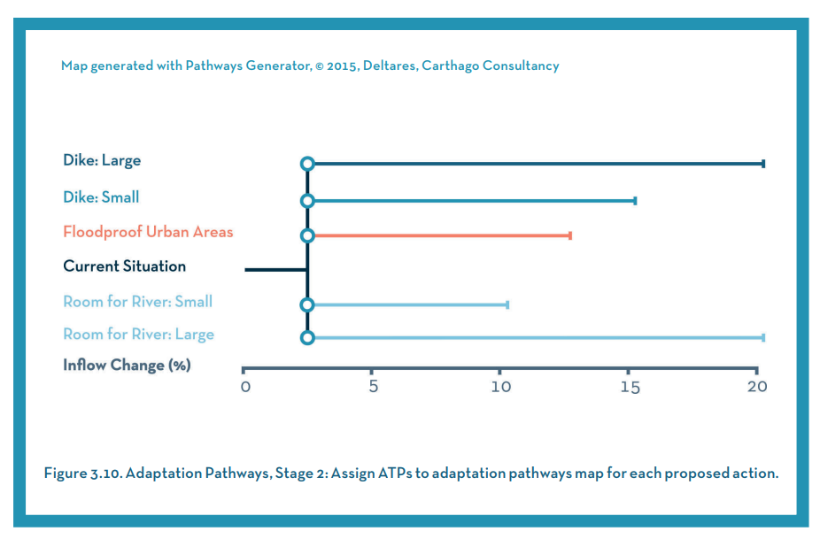
Developing Adaptation Pathways: Tipping Points

Slide 29
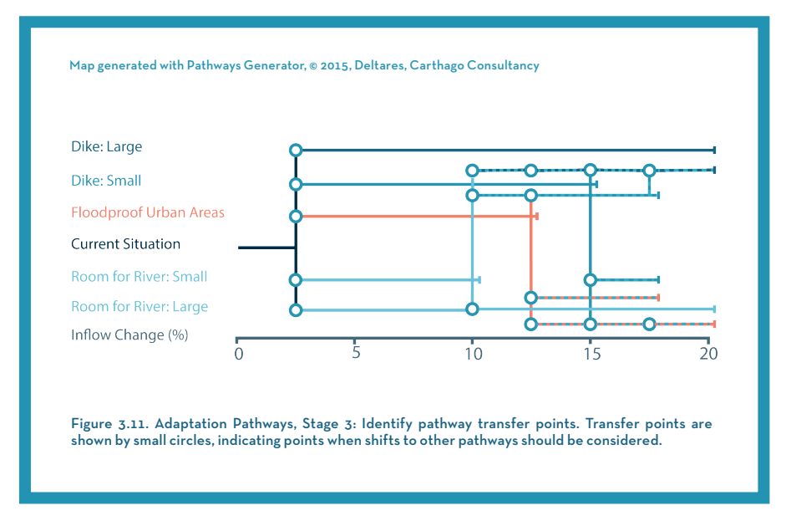
Identify Adaptation Pathways “Transfer Points”

Slide 30
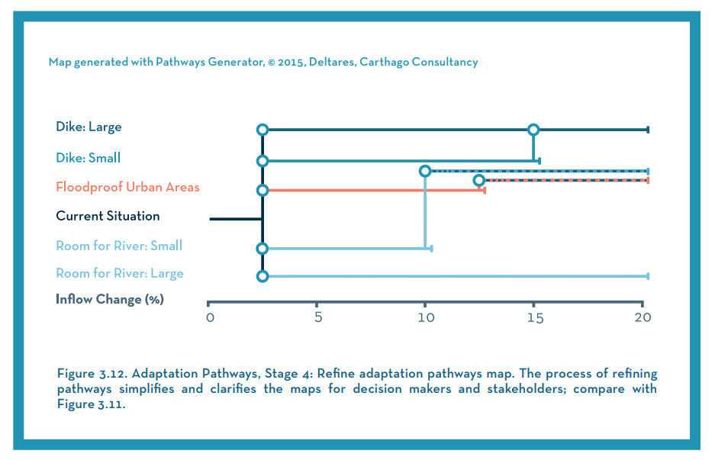
Simplifying the Adaptation Pathways Map

Slide 31
Step 4: Comparing and Recommending Plans
Input from Step 3
• Robust and flexible plans based on risk reduction, comprehensiveness and completeness, effectiveness in meeting planning objectives, and stakeholder acceptability
Output from Step 4
• Comparison of plans against a baseline measure of performance
• Comparison of plans across different future scenarios
• Recommended plan(s) to the decision maker

Slide 32
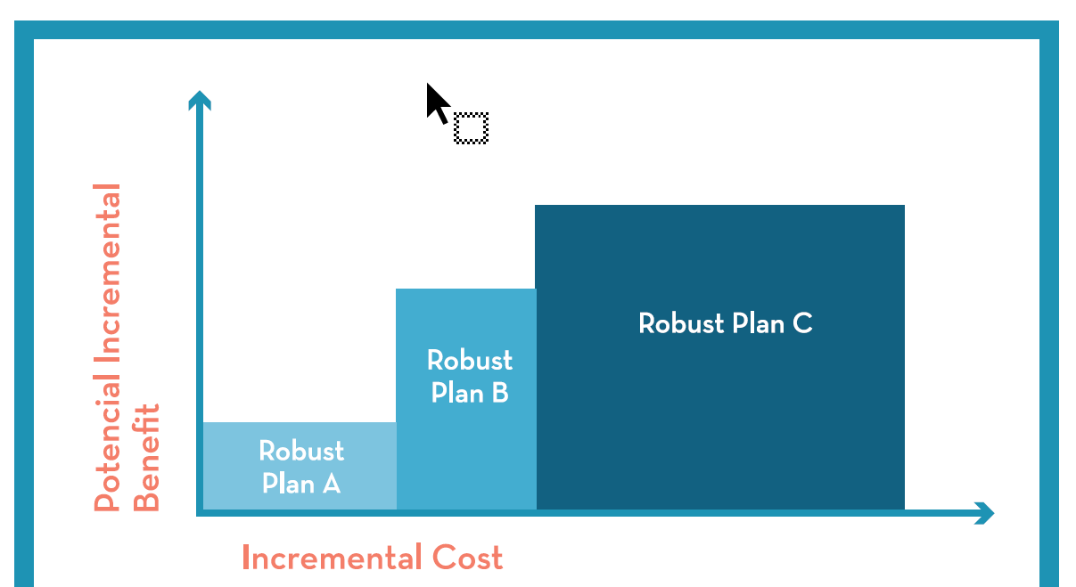
Incremental Cost Analysis

Slide 33
Unhelpful GCM-based Planning vs. Bottom-Up Scenario Planning with Stakeholders
Planning Scenarios
GCMs
Forecasting - Optimization (top-down)
3. Determine plausibility and consequence
1. Downscale multiple model projections
2. Hope the GCMs are correct.
3. Generate a few water supply series.
Critical climate and other urbanization stressors
2. Stress Test
4. Find whether system is vulnerable for these series
Scenario Planning – Risk Informed (bottom-up)
Vulnerability domain
Tested vulnerability domain
What keeps a planner awake at night?
1a. Perform Vulnerability Assessments with Stakeholders
Notes:
33

Slide 34
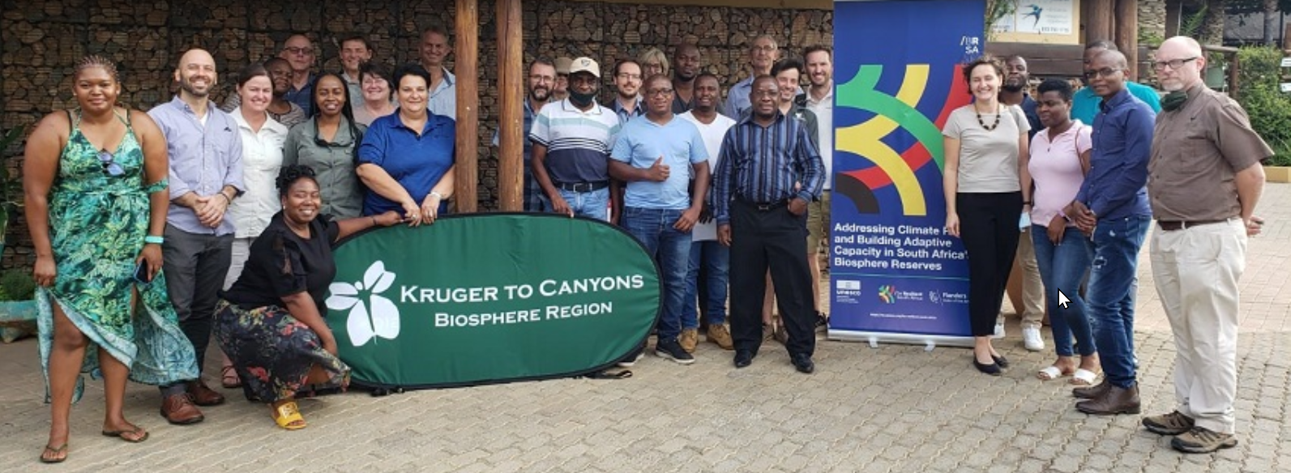
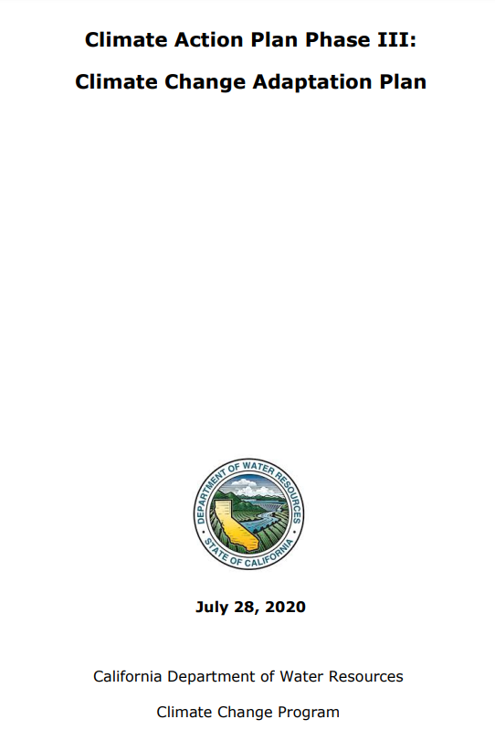
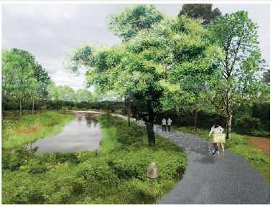
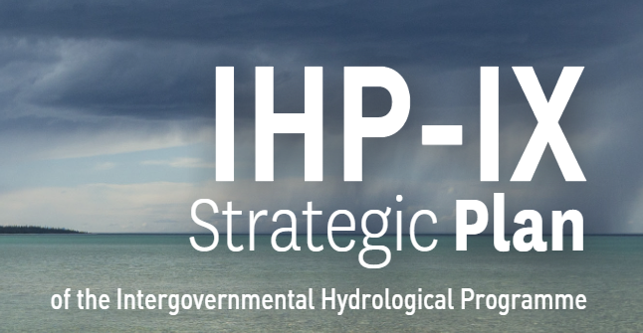
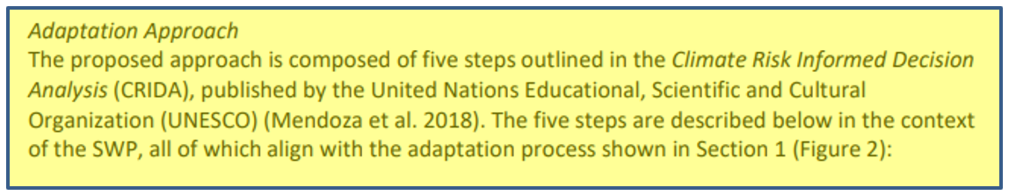
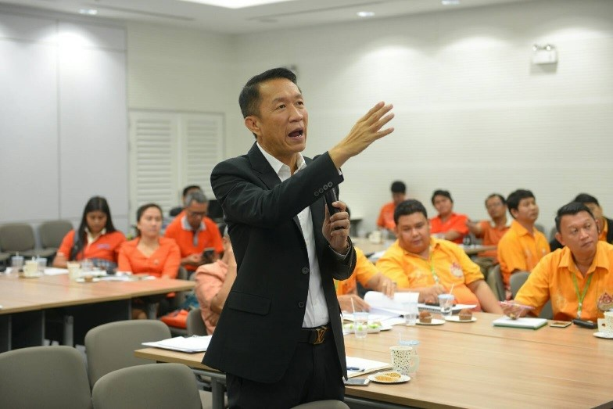
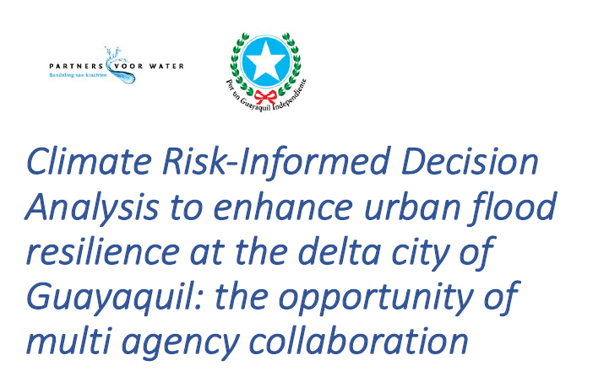

Who is using CRIDA?

Slide 35
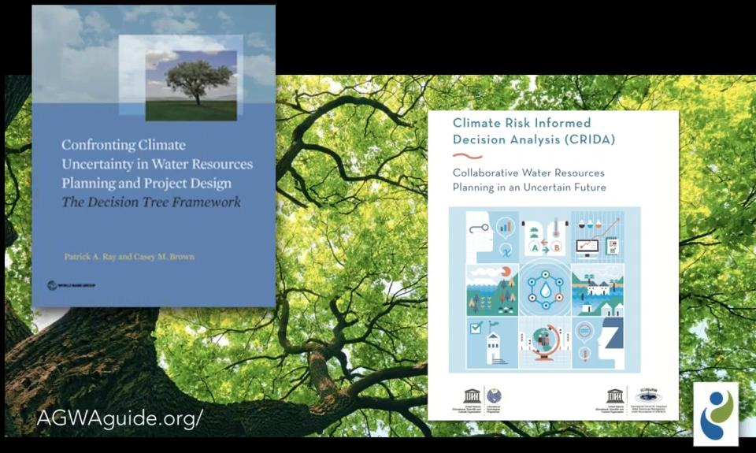
World Bank “Decision Tree Framework” and CRIDA

Slide 36


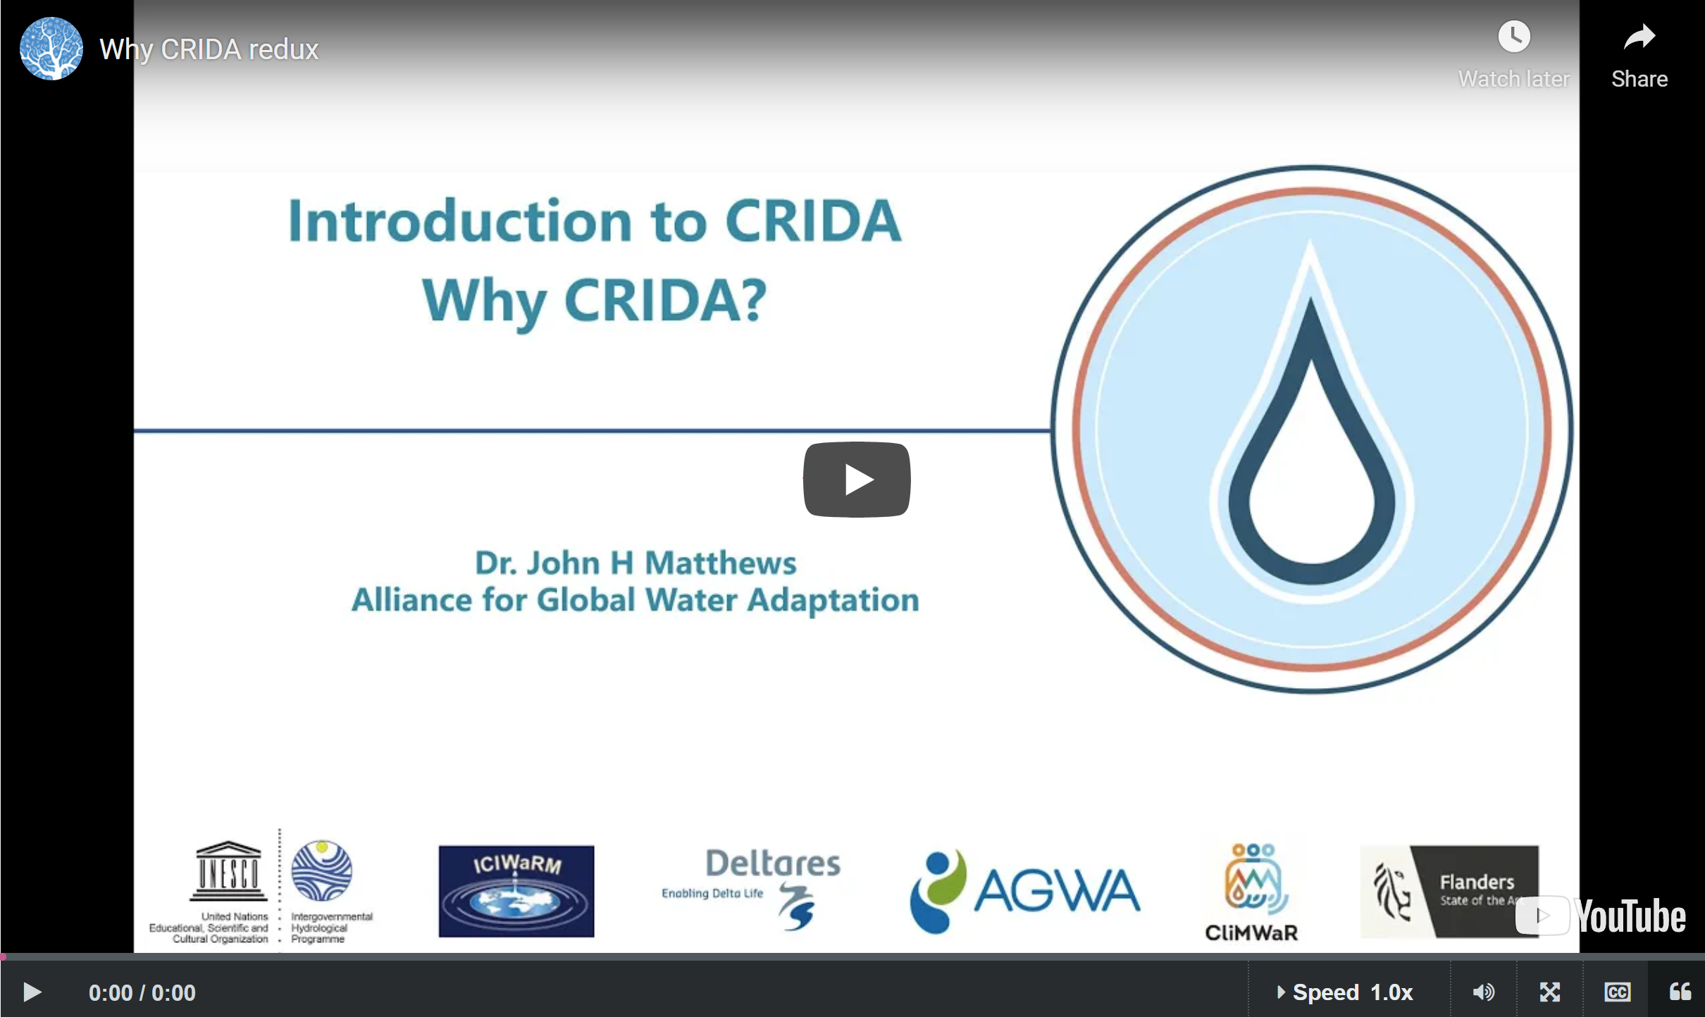
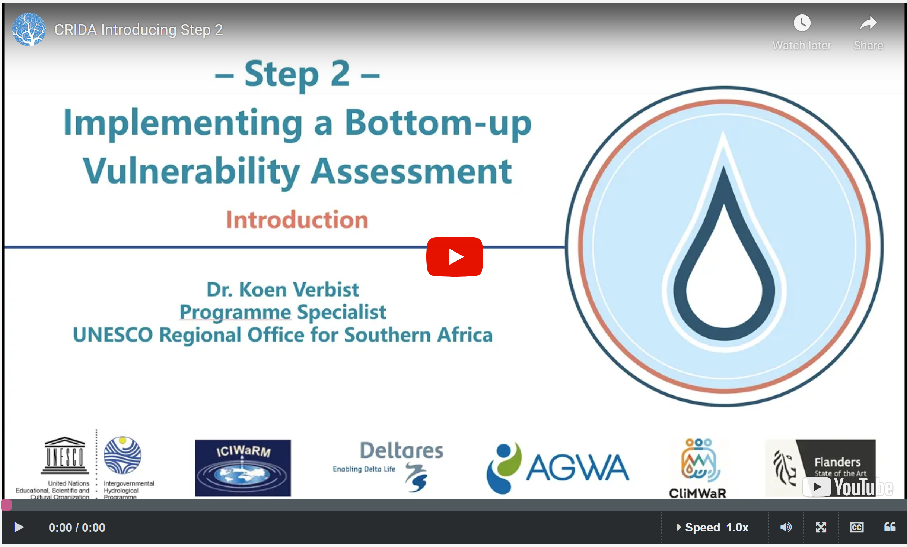
Capacity building as a tool for upscaling CRIDA
A CRIDA online course was developed in 2020, reaching already 2840 learners from 114 countries.
A Spanish and English version of the CRIDA course was launched in March 2022 and a French and Arabic (and repeat of English) in November 2022.
https://openlearning.unesco.org/

Slide 37
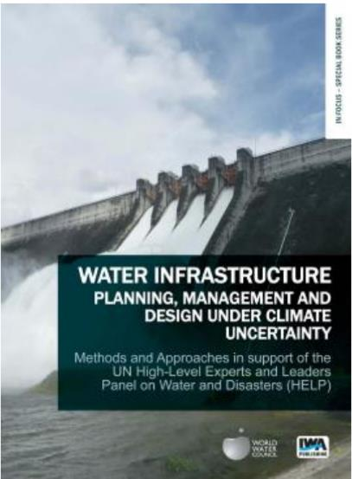
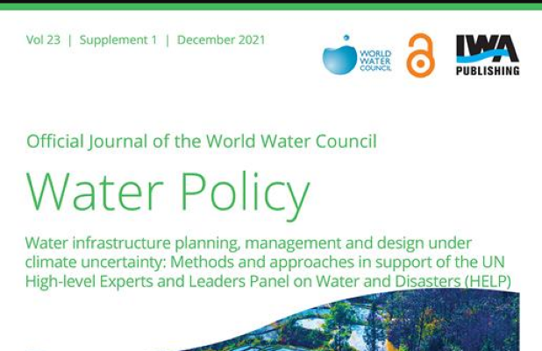
Thank you
https://iwaponline.com/wp/issue/23/S1

